Slide 1

Food Distribution Program
WBSCM Reports Part I
Entitlement
Texas Department of Agriculture
USDA Division

Slide 2
Acknowledgement Statement
You understand and acknowledge that:
The training you are about to take does not cover the entire scope of the program; and that
You are responsible for knowing and understanding all handbooks, manuals, alerts, notices, and guidance, as well as any other forms of communication that provide further guidance, clarification, or instruction on operating the program.

Slide 3

Why WBSCM?
The FDP Module in TX-UNPS does not have an upgrade.
Since 2010, TDA has used the Web Based Supply Chain Management System (WBSCM) to submit RA orders to USDA.
USDA owns and regularly upgrades WBSCM, making it the best solution to serve RAs in Texas now and in the future.
Notes:
Review information on slide with RAs

Slide 4

WBSCM Transition Page QR Code:
Scan QR Code to visit the Food Distribution Program WBSCM Transition website

Slide 5

01
Course Introduction
Course Outline and Objectives

Slide 6


Introduction
01
Course Overview and Objectives
Process and Terms Overview
02
Review Fulfilment Process, WBSCM Acronyms, Terms, Definitions, and Portal Components
03
Entitlement/Bonus Summary Report
Summary reports of program allocation and bonuses
WBSCM Entitlement Reports
Course Outline
Entitlement/Bonus Detailed Report
04
Review how each requisition impacts entitlement

Slide 7
Course Objectives and Outcomes
By the end of this course, participants will be able to:
Understand how to access and execute the Entitlement/Bonus Reports (both summary and detailed).
Identify where to locate beginning entitlement balance, remaining entitlement balance and bonuses for current and previous school years.
Review how transactions impact entitlement.

Slide 8
02
Process and Terms Overview
Fulfillment, WBSCM Terminology
and Portal Components

Slide 9

TX-UNPS to WBSCM Terms and Acronyms
TX-UNPS | Web-Based Supply Chain Management (WBSCM)
Contracting Entity (CE) | Recipient Agency (RA)
Texas Department of Agriculture (TDA) | State Distributing Agency (SDA)
Operations | Transactions
Survey | Catalog
Brown Box | Direct Delivery
Notes:
Review terminology changes with RAs

Slide 10
High Level Fulfillment Process
TDA
Distributes
Entitlement
RA
Submits
Requisition
(Req #)
TDA
Creates
Sales Order
USDA
Approves
Sales Order
(SO # Created)
Vendor
Fulfills SO
(PO # Created)
Goods
Delivered to Warehouse/
Processor
(Receipting)
WBSCM only has visibility from Entitlement to Initial Delivery Point
Notes:
NOTE: Initial delivery point will be warehouse (state-contracted or RA for Direct Ship RAs) or processors. RAs will use processor and warehouse tracking systems when materials requested in WBSCM arrive at the designated Ship-To/initial delivery point.

Slide 11
Training Portal Log-In
ESCs and RA Users Log In To WBSCM Training Environment
Login Required To Complete Assessment Questions
URL: wbscmntrn.wbscm.usda.gov
RA Training Environment Username and Password previously provided via e-mail.
Note the "ntrn" section of web address
This indicates the training environment
Notes:
Highlight the difference between training environment vs. Production URLs.
Production environment does not have the "ntrn" component in the web address.
Logins previously provided via to RAs for training environment
Log in to training environment will be different from login to username for live system which occurs after all required training is complete.

Slide 12
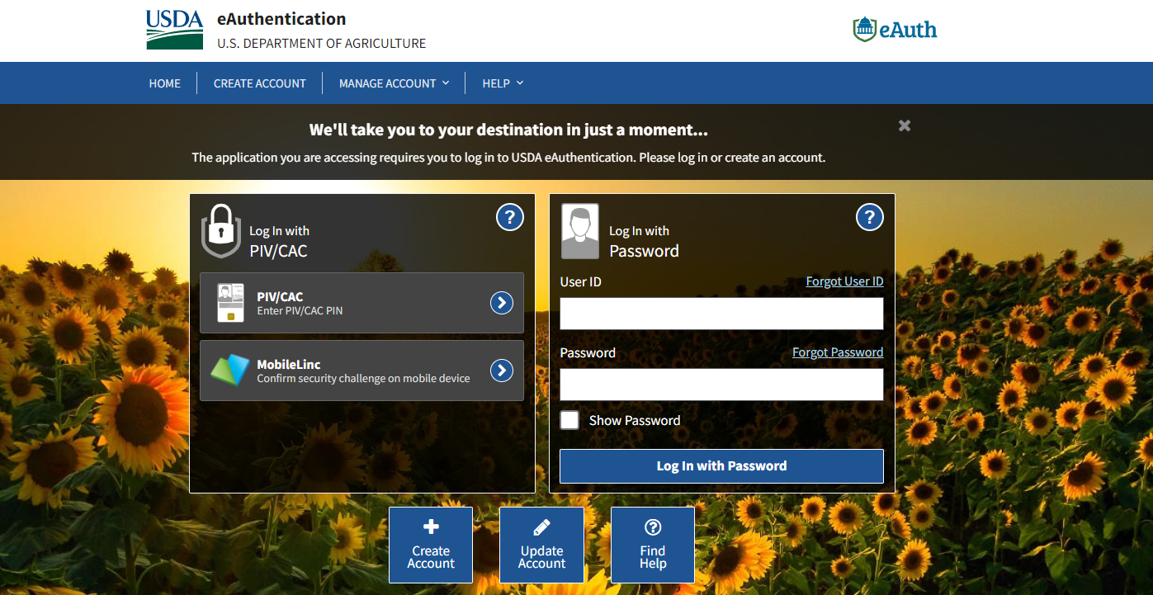
Log On To WBSCM
Enter eAuth ID
johnnie.smith@anytownisd.org
*eAuth IDs may be:​
Email Address, or​
Numbers (e.g. 17623), or​
Numbers and @ (e.g. 17@6342), or​
Letters and Numbers (e.g. SM1974)
Enter password
yourpassword
Hit log in button
Notes:
HIDDEN:
This screenshot shows a sample of WBSCM Live Production Environment Login Possibilities.
Users will not log in to Live Environment until after all training is complete and Live Accounts have been registered and activated.

Slide 13

Log On To WBSCM Training Environment
Enter Training User Login
Training Environment Login Page looks identical to Live Production Login Page.
Bookmark and name training environment link to minimize login errors.
traininguserinfo@training.org
assigned.training.password
Enter training password
Hit log in button
Notes:
TRAINER NOTE:
Training Environment and Live Production Log In Page will look the same.
Bookmark training environment which includes “ntrn” in the URL.
Training environment logins will include no personal user information.
Each ESC region assigned their own set of training logins to distribute between Ras
The next slides will be a review of WBSCM RA view and reminder to check for new content. Will be particularly helpful for those conducing training over multiple weeks.

Slide 14

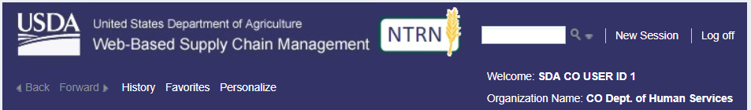
Training Environment Log-In
RA Training Environment View
NTRN icon signals training environment.
User and Organization Name
ESC Training Environment View
NTRN icon signals training environment.
User and Organization Name
Notes:
User name and organization will show different user roles.
Differences in navigation panels will be determined based on roles/level of access.
Let participants know that NTRN is the Training Environment.

Slide 15
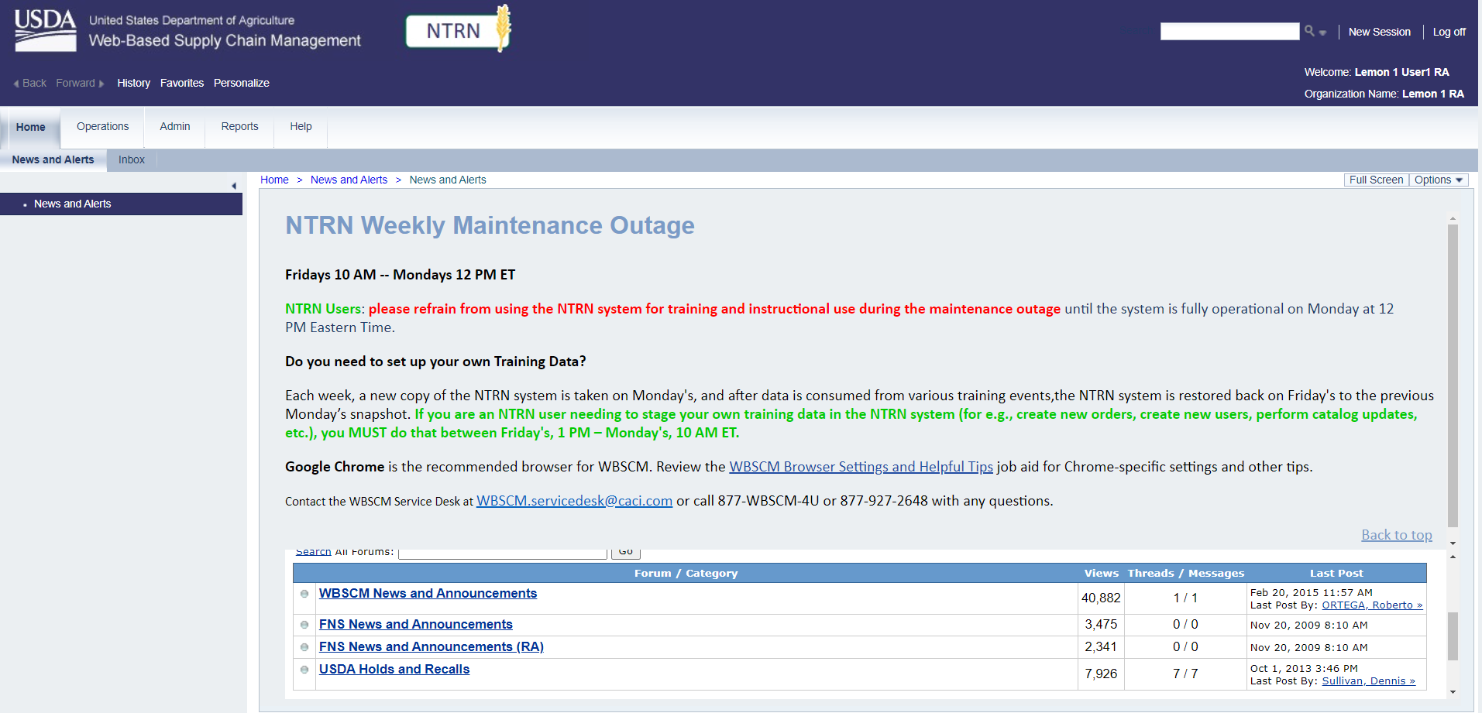
Check for New Content
Check Forum for updates.
Notes:
Reminder to check WBSCM Splash Page (especially when users are able to access Live Production Environment after account set up for announcements and updates).
Remind users that NTRN goes into refresh Friday through Monday.
Use NTRN Tuesdays through Thursdays.

Slide 16
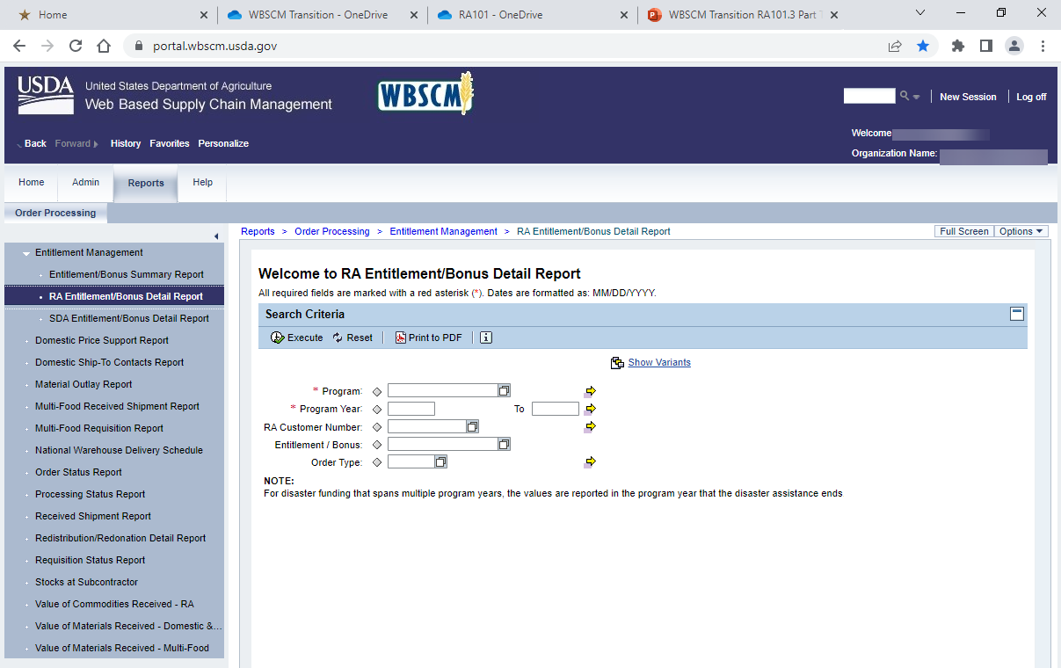
WBSCM Portal Screen Components
2
2. Level 1 Module Tabs: (level 1 options here)
  Provide highest level of navigation
  Tabs available depend on the user’s roles in WBSCM.
Notes:
Review WBSCM Portal Component information on slide

Slide 17
WBSCM Portal Screen Components
3
3. Level 2 Tabs:
  Sub-menu options for level 2.
Notes:
Review WBSCM Portal Component information on slide

Slide 18
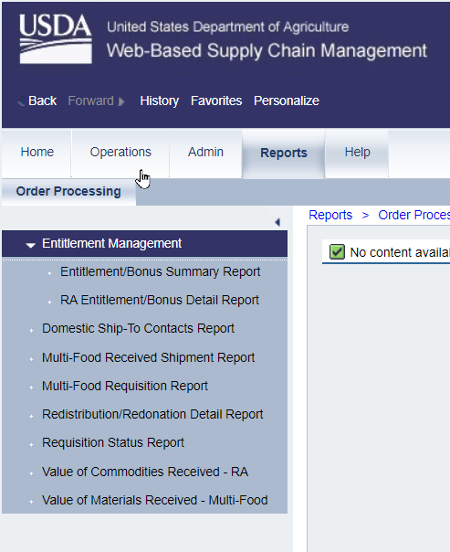
WBSCM Portal Screen Components
4. Detailed Navigation Panel:
  List of transaction options under Level 2 tabs.
    Ex: Transaction options for Level 2 Tab "Order Processing" are listed in the panel.
  Transaction options based on user role within WBSCM.
4
Notes:
Review WBSCM Portal Component information on slide

Slide 19
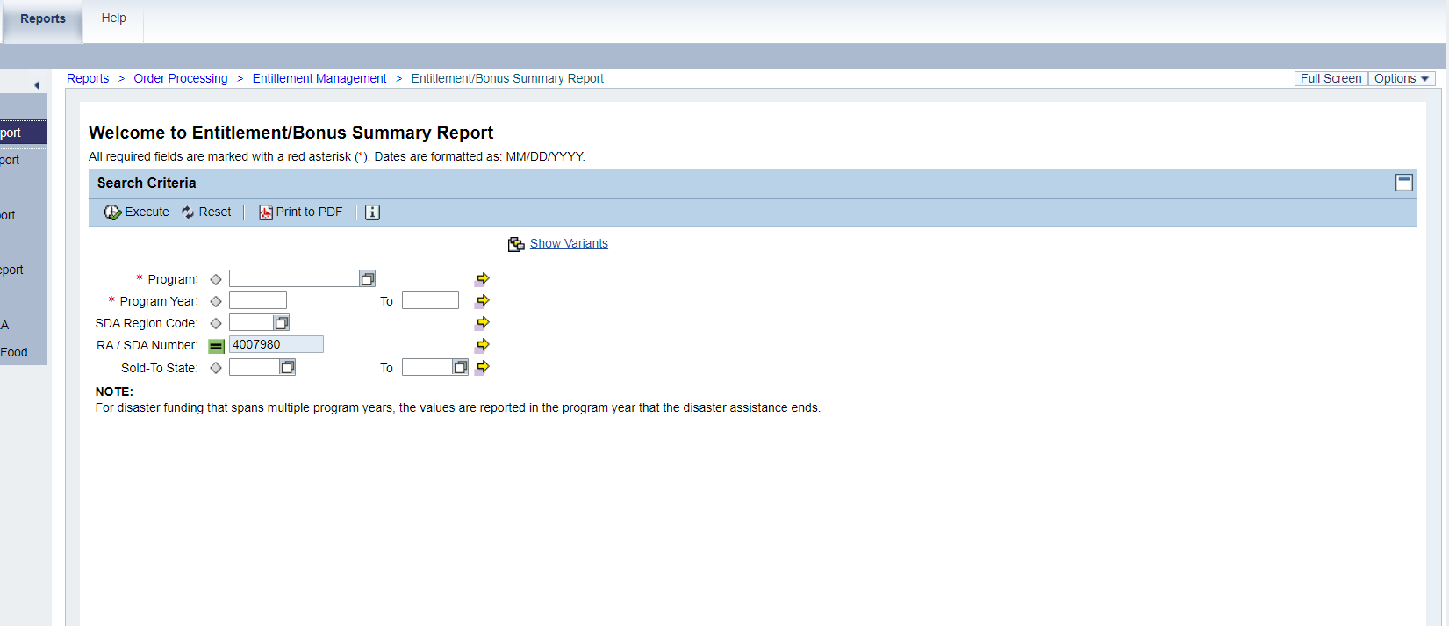
WBSCM Portal Screen Components
5
5. Content area:
  Used to enter or view details and execute transactions.
Notes:
Review WBSCM Portal Component information on slide

Slide 20
03
Entitlement/Bonus Summary Report
Program Allocation and Bonuses

Slide 21


WHEN
WHY
Run this report at the beginning and throughout the desired program year.
To obtain a summary or quick snapshot of beginning and remaining entitlement balances and bonuses.

Slide 22
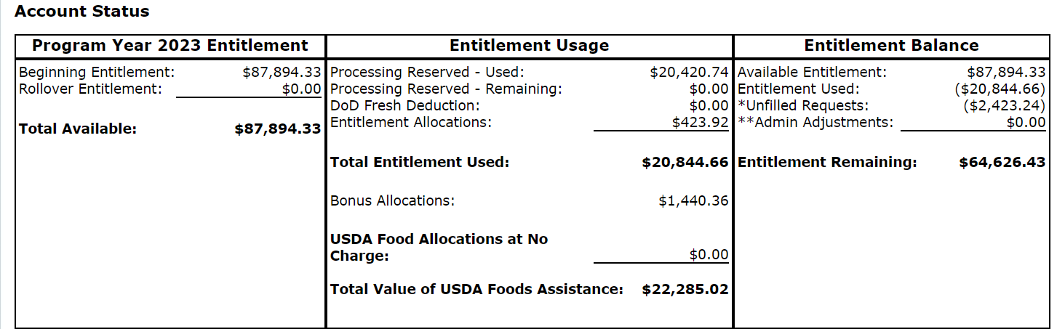


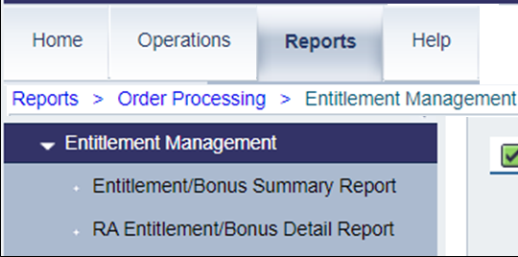
TX-UNPS Commodity Bulletin Equivalent
Entitlement Usage (TXUNPS)
Weekly Commodity Bulletin
Reports Module in WBSCM
Entitlement Summary Report
Entitlement Detail Report
Notes:
Entitlement balances previously found in the TX-UNPS Weekly Commodity Bulletin will now be accessed under Reports → Entitlement Management
The RA Order Manager and RA View Only user roles will have access to Entitlement Reports
Processing Reserved Used and Remaining will not be tracked separately in WBSCM.
Processing and Direct Delivery entitlement will not need to be pre-designated in WBSCM.
Entitlement funds in WBSCM include both Processing and Direct Delivery; they are comingled.

Slide 23
TX-UNPS Commodity Bulletin Equivalent
In WBSCM, Entitlement funds include both Processing and Direct Delivery; they are comingled.
In WBSCM, Processing amounts will not need to be reserved or earmarked as previously done in TX-UNPS.
Notes:
Review information on slide with RAs

Slide 24
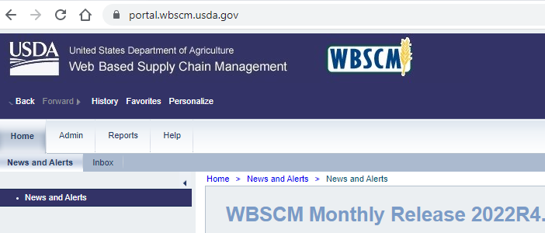
Running Entitlement Summary Report
To access Entitlement/Bonus Summary Report, follow the steps on each slide.
1
Click on reports
Notes:
To access Entitlement Summary Report, follow the next set of steps on each slide.
RAs would run this report to view their:
beginning entitlement balance-
remaining entitlement balance
DoD allocation if opted in to DoD Fresh.
bonuses for the selected/desired Program Year. For Texas staged Data in training envrionment, RAs will use Program Year 2023.
Entitlement Order Total
Entitlement Pounds
Entitlement Balance
More detailed information will be provided on report view slides.

Slide 25
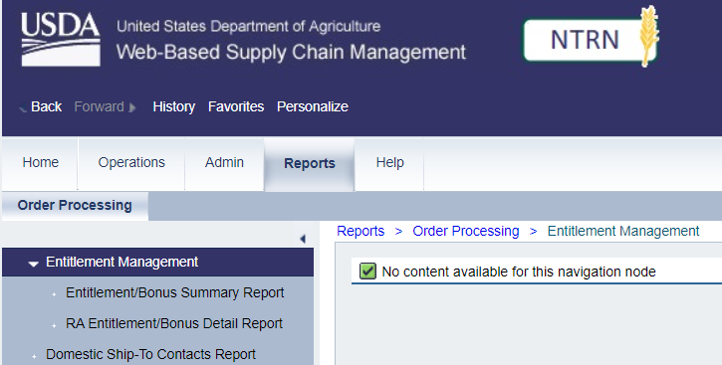
Running Entitlement Summary Report
2
Click on Entitlement Management
Notes:
Review Entitlement Pathway information on slide

Slide 26
Running Entitlement Summary Report
3
Click on Entitlement/Bonus Summary Report
Notes:
Review Entitlement Pathway information on slide

Slide 27
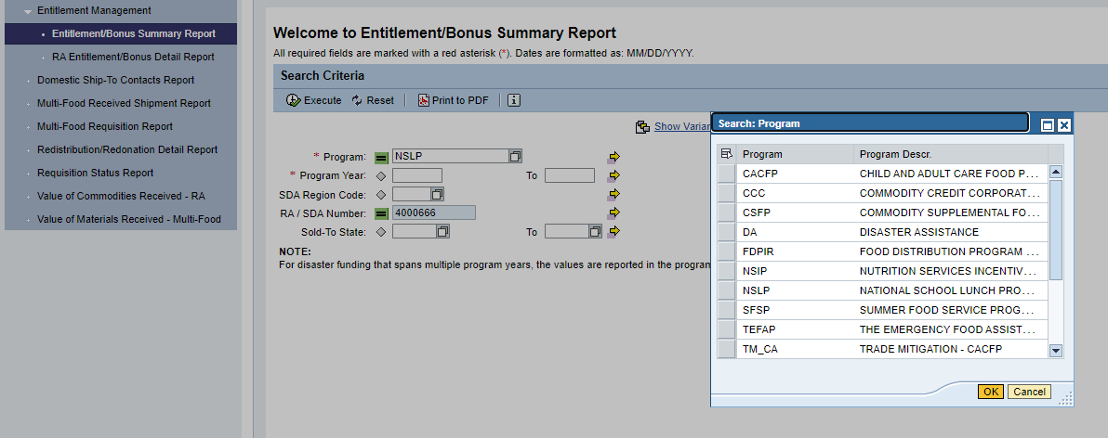
Running Entitlement Summary Report
4
Type NSLP into Program Box OR
Click on the square icon to choose program from pop-up box
Notes:
Review Entitlement Pathway information on slide

Slide 28
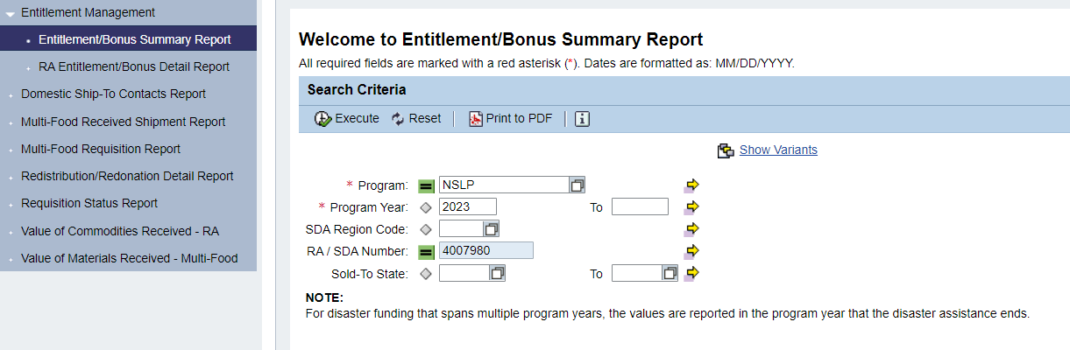
Running Entitlement Summary Report
5
*If current school year is 2022-2023 enter 2023 for Program Year.
Reports for previous years can be run if desired once historical data is available.
Notes:
TRAINER NOTE:
For Entitlement Summary Report Staged data also available in NTRN for School Year 2023-2024. May enter 2024 into Program Year field if desired
No staged data exists for future School/Program Years yet.

Slide 29
Running Entitlement Summary Report
6
RA (or SDA) Number will auto-populate
Notes:
Review information on slide with RA

Slide 30
Running Entitlement Summary Report
Click execute when all required fields are entered.
7
Notes:
Review information on slide with RA

Slide 31
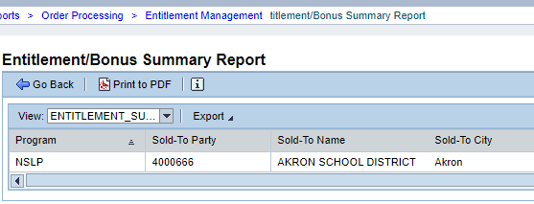
Running Entitlement Summary Report
Report will appear in Main Content Area. Can view in Main Content Area OR:
Option 1: Click on Print to PDF
Notes:
Review available info on PDF Report to compare with Excel Export.
Use of Excel over PDF is encouraged as not all columns with information appears in PDF.

Slide 32
Running Entitlement Summary Report
Option 2:
Export to Microsoft Excel
Notes:
Review information on slide with RAs

Slide 33
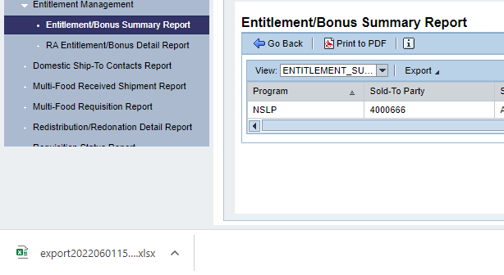
Running Entitlement Summary Report
In Chrome, Excel Report will appear at the bottom of screen.
Click on file to open.
Notes:
COMPARE WITH PDF REPORT

Slide 34
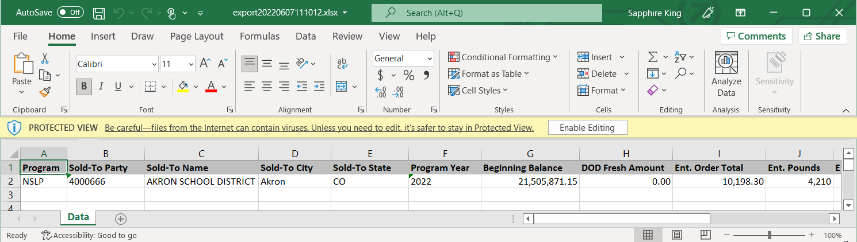
Running Entitlement Summary Report
May have to Enable Editing if presented with option before opening file.
Scroll bar at bottom to see all columns.
Notes:
The next slides will review the information located in each column of the Excel Report.

Slide 35
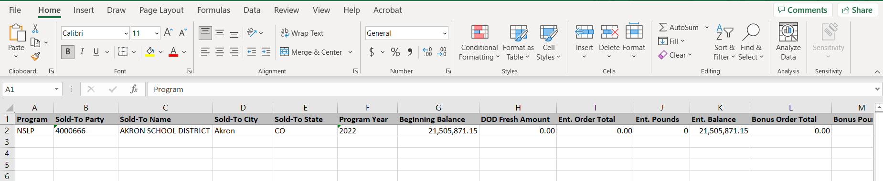
Running Entitlement Summary Report
RA WBSCM ID Number
Notes:
Review information on slide with RAs

Slide 36
Running Entitlement Summary Report
RA Name
Notes:
Sold-To Name will include RA Organization Name

Slide 37
Running Entitlement Summary Report
RA City and State
Notes:
Review information on slide with RAs

Slide 38
Running Entitlement Summary Report
Program Year Being Reviewed
Notes:
Review information on slide with RAs
Example shows Program 2022 Year data

Slide 39
Running Entitlement Summary Report
Beginning Balance:
The total share of entitlement available to an RA at the beginning of the school year. This is a dollar value.
Notes:
Beginning Balance – This is the total share of entitlement given to the RA

Slide 40
Running Entitlement Summary Report
Beginning USDA Entitlement for School Year Being Reviewed
If viewing current year entitlement report, Beginning Balance may be differing in September/October.
Entitlement Balance references funds that can be used for Direct Delivery and Processing.
Notes:
Beginning Balance – This is the total share of entitlement given to the RA

Slide 41
Running Entitlement Summary Report
Dollar value of entitlement allocated to the DOD Fresh Fruits and Vegetables program.
Notes:
DoD Fresh Amount – This will be allocated by TDA

Slide 42
Running Entitlement Summary Report
The dollar value of all entitlement orders placed for Direct Delivery and Processing through WBSCM
Does not include DOD Fresh ordered through FFAVORS (Fresh Fruit and Vegetable Order Receipt System).
Notes:
Ent Order Total – This will be all orders placed for Direct Delivery and processing

Slide 43
Running Entitlement Summary Report
The amount of entitlement pounds for Direct Delivery & Processing (DD&P) ordered through WBSCM
(Does not include DOD Fresh)
Notes:
The amount of entitlement pounds ordered through WBSCM; does not include DoD Fresh ordered through FFAVORS.

Slide 44
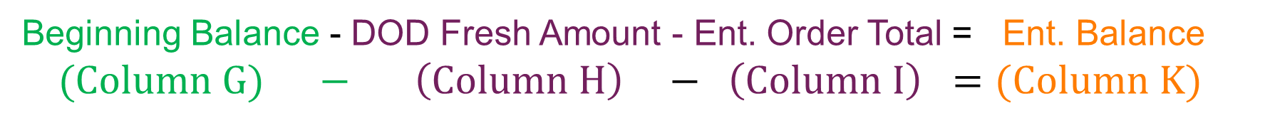
Running Entitlement Summary Report
Entitlement Remaining after all Processing and Direct Delivery pounds have been allocated
Beginning Balance - DOD Fresh Amount - Ent. Order Total = Ent. Balance
(Column $G) − \left(Column H\right) − \left(Column I\right) =(Column K)$
Notes:
Review information on slide with RAs
NOTE:
Beginning Balance – This is the total share of entitlement given to the RA
DoD Fresh Amount – This will be allocated by the SDA (balance will likely never change here unless TDA updates after reconciliation of balances in FFAVORS)
Ent Order Total – This will be all orders placed for brown box/processing placed in WBSCM
Ent Balance: The amount of entitlement remaining after Direct Delivery and Diverted Pounds have been allocated.
Ent Balance – Will be the result of H(DoD Fresh Amount) and I(Ent Order Total) subtracted from G(Beginning Balance)
Formula : K= G- (H+I)

Slide 45
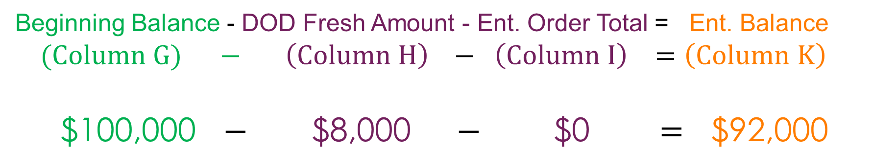
Entitlement Balance: Example 1
$100,000.00
$8,000.00
$92,000.00
Beginning Balance - DOD Fresh Amount - Ent. Order Total = Ent. Balance
(Column $G) − \left(Column H\right) − \left(Column I\right) =\left(Column K\right)$
$100,000 $−$ $8,000 $−$ $0 = $92,000
Available
for DD&P
Notes:
Review information on slide with RAs
NOTE:
Beginning Balance – This is the total share of entitlement given to the RA
DoD Fresh Amount – This will be allocated by the SDA (balance will likely never change here unless TDA updates after reconciliation of balances in FFAVORS)
Ent Order Total – This will be all orders placed for brown box/processing placed in WBSCM
Ent Balance: The amount of entitlement remaining after Direct Delivery and Diverted Pounds have been allocated.
Ent Balance – Will be the result of H(DoD Fresh Amount) and I(Ent Order Total) subtracted from G(Beginning Balance)
Formula : K= G- (H+I)

Slide 46
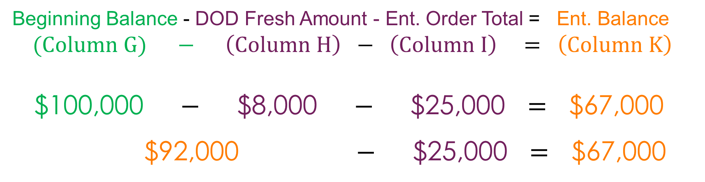
Entitlement Balance: Example 2
$100,000.00
$8,000.00
$25,000.00
$67,000.00
Beginning Balance - DOD Fresh Amount - Ent. Order Total = Ent. Balance
(Column $G) − \left(Column H\right) − \left(Column I\right) = \left(Column K\right)$
$100,000 $−$ $8,000 $−$ $25,000 = $67,000
$92,000 $−$ $25,000 = $67,000
Available
for DD&P
Notes:
Review information on slide with RAs
NOTE:
Beginning Balance – This is the total share of entitlement given to the RA
DoD Fresh Amount – This will be allocated by the SDA (balance will likely never change here unless TDA updates after reconciliation of balances in FFAVORS)
Ent Order Total – This will be all orders placed for brown box/processing placed in WBSCM
Ent Balance: The amount of entitlement remaining after Direct Delivery and Diverted Pounds have been allocated.
Ent Balance – Will be the result of H(DoD Fresh Amount) and I(Ent Order Total) subtracted from G(Beginning Balance)
Formula : K= G- (H+I)

Slide 47
Running Entitlement Summary Report
Total Bonus
Notes:
If Bonus has been used to request commodities, total will reflect in the Bonus Order Total Column

Slide 48

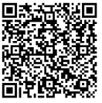
Knowledge Check:
Scan QR Code or visit the Link below to access the Knowledge Check
https://bit.ly/3XM2nsE
Notes:
RAs submit Assessment Responses via QR code or link/URL
Knowledge Check can be viewed as a matching activity on the next slide
Allow for collaboration if desired.
RAs must submit to receive training credit

Slide 49
Knowledge Check
Match the term on the left to the correct definition.
WBSCM Entitlement Summary Report Terms
Term
1.Entitlement Order Total
2. Entitlement Pounds
3. Beginning Balance
4. DOD Fresh Amount
5. Entitlement Balance
Definition
A. Balance of entitlement available to a school at the beginning of the school year. This is a dollar value.
B. Dollar value of entitlement allocated to the DOD Fresh Fruits and Vegetables program.
C. The dollar value of entitlement ordered through WBSCM; does not include DOD Fresh ordered through FFAVORS (Fresh Fruit and Vegetable Order Receipt System).
D. The amount of entitlement pounds ordered through WBSCM; does not include DoD Fresh ordered through FFAVORS.
E. The amount of entitlement remaining after Direct Delivery and Diverted Pounds have been allocated.
Notes:
TRAINER NOTE:
Allow for collaboration if desired. Each click will reveal the matched term to definition.

Slide 50
04
Entitlement/Bonus Detailed Report
Program Allocation and Bonuses

Slide 51
WHEN
WHY
Run this report after requisitions for materials have been placed in WBSCM.
To review how each item requested impacts entitlement balance and view how much entitlement is remaining.
Notes:
Review information on slide with RAs

Slide 52

TX-UNPS Commodity Bulletin Equivalent
Entitlement Balance (TXUNPS)
Weekly Commodity Bulletin
Reports Module in WBSCM
Entitlement Detail Report
Notes:
Entitlement balances previously found in the TX-UNPS Weekly Commodity Bulletin will now be accessed under Reports → Entitlement Management
The RA Order Manager and RA View Only user roles will have access to Entitlement Reports

Slide 53
Running Entitlement Detail Report
To access Entitlement/Bonus Detail Report, follow the steps on each slide.
1
Click on reports
Notes:
To access Entitlement/Bonus Detail Report, follow the next set of steps on each slide.
RAs would run this report to view:
All transactions that impact RA entitlement, as well as...
Order Quantities
Unit of Measure for requests
Order Quantity in LB
Avg. Cost/Lb
Entitlement Amount Availabl <--- WBSCM does not include the letter "e" at the end of the world Available
Entitlement Amount Pending

Slide 54
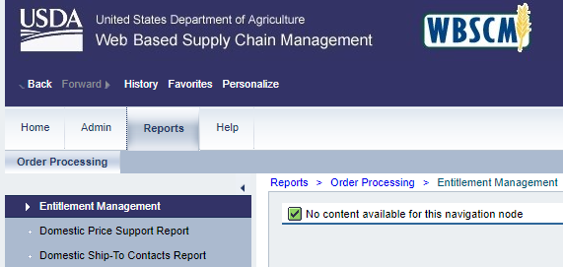
Running Entitlement Detail Report
2
Click on Entitlement Management
Notes:
Review information on slide with RAs

Slide 55
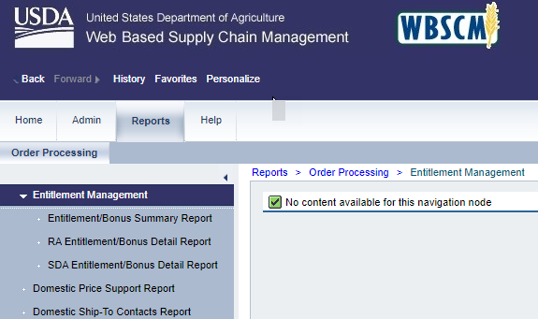
Running Entitlement Detail Report
3
Click on Entitlement/Bonus Detail Report
Notes:
Review information on slide with RAs

Slide 56
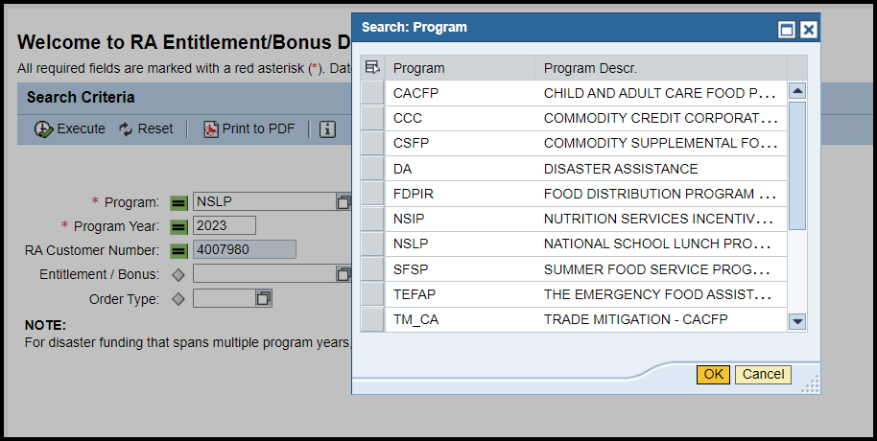
Running Entitlement Detail Report
Click on square icon for pop-up box.
Pop-up box.
4
Type NSLP into Program Box
OR
Click on the square icon to choose program from pop-up box
Notes:
Review information on slide with RAs

Slide 57
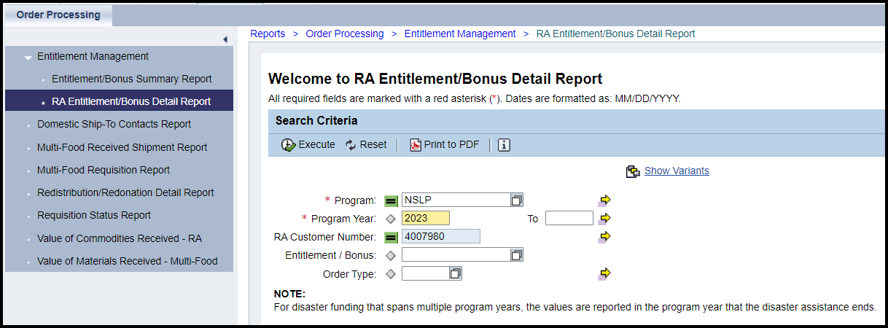
Running Entitlement Detail Report
Type in 2023 for the 2022-2023 School Year
Reports for previous years can be run if desired once historical data is available.
5

Slide 58
Running Entitlement Detail Report
*If current school year is 2022-2023 enter 2023 for Program Year.
Reports for previous years can be run if desired once historical data is available.
6
Notes:
TRAINER NOTE:
Use Program Year example on the slide (2023) to demonstrate and pull staged data
No staged data exists for Program Year 2024 for Entitlement Detail Report or for any other future School/Program Years yet.

Slide 59
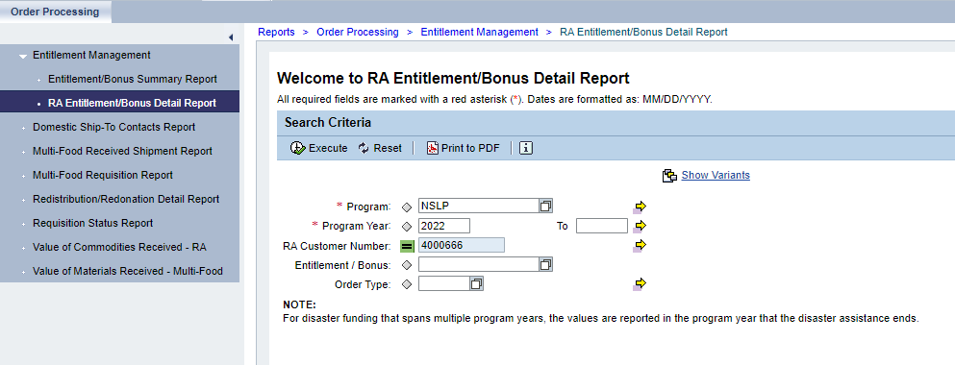
Running Entitlement Detail Report
7
Click Execute when all required fields are entered.
Notes:
Review information on slide with RAs

Slide 60
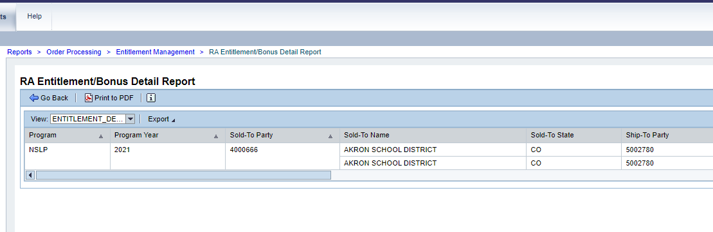
Running Entitlement Summary Report
Report will appear in Main Content Area. Can view in Main Content Area OR:
Option 1: Click on Print to PDF
Notes:
Review available info on PDF Report to compare with Excel Export

Slide 61
Running Entitlement Detail Report
Option 2:
Export to Microsoft Excel
Notes:
Ask participants to download to PDF and also export to Excel so they can discover the limitations of PDF vs. Excel.

Slide 62
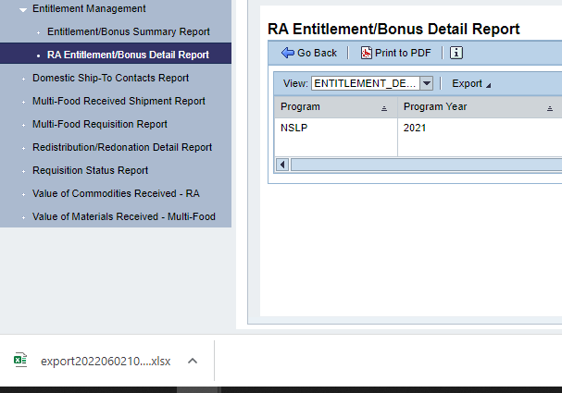
Running Entitlement Detail Report
In Chrome, Excel Report will appear at the bottom of screen.
Click on file to open.
Notes:
Review information on slide with RAs

Slide 63
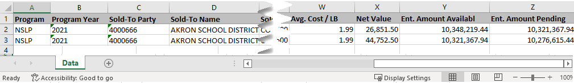
Running Entitlement Detail Report
Twenty-six columns of information found in Entitlement/Bonus Detail Report
Scroll bar at bottom to see all columns.
Notes:
The next slides will review the information located in each column of the Excel Report.

Slide 64
Running Entitlement Detail Report
Program (NSLP) and Program Year Being Reviewed
Notes:
Review information on slide with RAs
Staged Data/Reports may include different Program Years based on Program Year entered in training environment

Slide 65
Running Entitlement Detail Report
RA WBSCM ID Number
Notes:
Review information on slide with RAs

Slide 66
Running Entitlement Detail Report
RA Name and State
Notes:
Review information on slide with RAs

Slide 67
Running Entitlement Detail Report
WBSCM ID for business partner/ organization receiving materials.
Can include:
State-Contracted Warehouse(s)
Direct Ship RA Warehouses
Processor
Notes:
Review information on slide with RAs

Slide 68
Running Entitlement Detail Report
Will display name of the business partner/organization receiving materials.
Can include:
State-Contracted Warehouse(s)
Direct Ship RA Warehouses
Processor
Notes:
Review information on slide with RAs

Slide 69
Running Entitlement Detail Report
Hide This Column
Not Needed
Notes:
Review information on slide with RAs

Slide 70
Running Entitlement Detail Report
Hide This Column If Not Needed
Notes:
Review information on slide with RAs

Slide 71
Running Entitlement Detail Report
Hide This Column If Not Needed
Notes:
Review information on slide with RAs

Slide 72
Running Entitlement Detail Report
Entitlement or Bonus
Notes:
This column notes whether Entitlement or Bonus was used for requisition.

Slide 73
Running Entitlement Detail Report
Date Materials Were Ordered
Notes:
Review information on slide with RAs

Slide 74
Running Entitlement Detail Report
Hide Column If Not Needed
Notes:
Review information on slide with RAs

Slide 75
Running Entitlement Detail Report
USDA assigned Sales Order # (i.e., 5000…)
WBSCM designates this number after TDA submits RA requests.
All SOs begin with the #5.
Notes:
Review information on slide with RAs

Slide 76
Running Entitlement Detail Report
Suffix to Sales Order designating specific delivery stop.
Notes:
Review information on slide with RAs

Slide 77
Running Entitlement Detail Report
Status of the Order
1) Approved by SDA (TDA)* | Requisition has been processed and approved by SDA (TDA) and sent to USDA (modifications and cancellations can still be accessed at this point).
2) Approved by SPA | Order is being finalized and prepared for procurement by USDA. This leads to "On Invitation" and/or "Purchased" status.
3) On Invitation | Order that has been placed on a bid invitation by Food and Nutrition Services (FNS)
4) Returned by FSA/AMS | Returned by Farm Service Agency/Agricultural Marketing Service to TDA
5) Purchased/Price Final* | USDA purchased truck
6) Order Received* | Truck arrived at warehouse or processor
*Highlighted rows most frequently used by RAs
Notes:
RAs would look at this to know the status of their request that TDA ordered.
The most important ones for them to pay attention to are Approved by SDA, Approved by SPA, Purchased (it will let them know USDA purchased the truck) and Order Received (tells them the truck made it to their warehouse or processor).

Slide 78
Running Entitlement Detail Report
USDA Assigned Item/Material #
Notes:
Review information on slide with RAs

Slide 79
Running Entitlement Detail Report
Item/Material Description. Usually includes a pack size.
Notes:
Review information on slide with RAs

Slide 80
Running Entitlement Detail Report
Latest date the load is expected to be delivered to the assigned Ship-To.
  Ex: 6/30/21 should be delivered between 06/16/21-06/30/21
Ship-To can include:
  State Contracted Warehouse
  Direct Ship RA Warehouse
  Processor(s).
Notes:
Review information on slide with RAs

Slide 81
Running Entitlement Detail Report
Quantity of material an RA has requested
(# of cases or pounds requested)
Notes:
Review information on slide with RAs

Slide 82
Running Entitlement Detail Report
How the Order Quantity is measured
LB = Pounds
CS = Cases
Notes:
Review information on slide with RAs

Slide 83
Running Entitlement Detail Report
Weight of the material ordered in pounds
Notes:
Review information on slide with RAs

Slide 84
Running Entitlement Detail Report
Dollar value of cases or LB ordered.
Notes:
Review information on slide with RAs

Slide 85
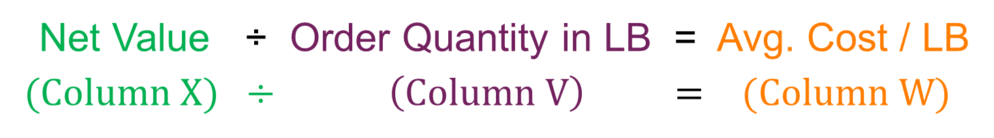
Running Entitlement Detail Report
Net Value of the material divided by
Order Quantity in LB = Avg. Cost/LB
Net Value ÷ Order Quantity in LB = Avg. Cost / LB
(Column $X) ÷ \left(Column V\right) = (Column W)$
Notes:
Average Cost (Column W) is calculated by dividing Net Value by Order Quantity in LB

Slide 86
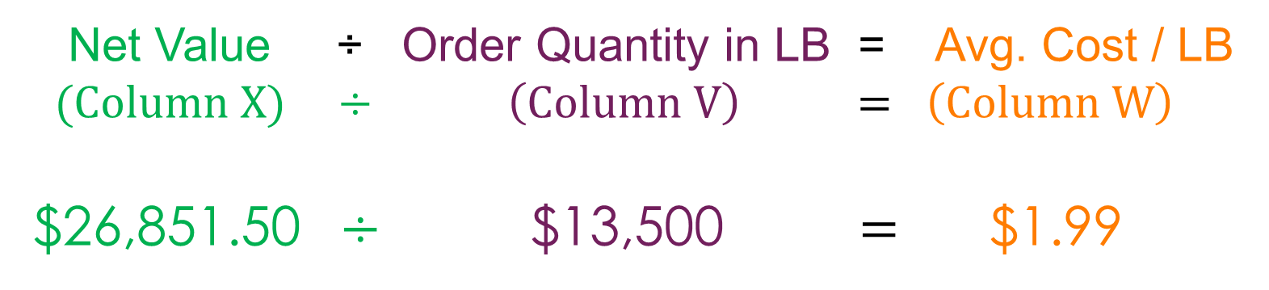
Avg. Cost/LB Calculation
Net Value ÷ Order Quantity in LB = Avg. Cost / LB
(Column $X) ÷ \left(Column V\right) = \left(Column W\right)$
$26,851.50 $÷$ $13,500 = $1.99
Notes:
Divide the Net Value of the line item (26,851.50) by the Order Quantity in LB for that line item ($13, 500) to determine the Avg. Cost/LB for that line ($1.99)

Slide 87
Running Entitlement Detail Report
Entitlement Balance Availabl
Amount of entitlement available at the time the item had been requested (requisition).
Notes:
Review information on slide with RAs
*NOTE: WBSCM does not include the letter "e" in the word Available when referencing Entitlement Balance Available.

Slide 88
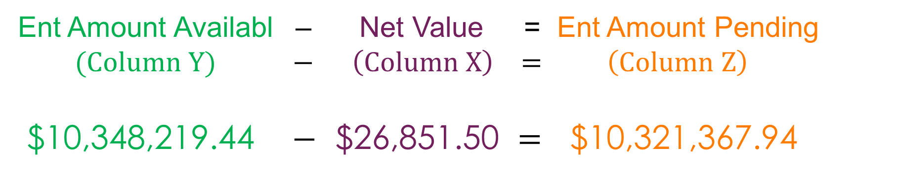
Running Entitlement Detail Report
Ent. Amount Pending
Ent. Amount Pending calculated by taking the Ent Amount Availabl at the time the material was requested minus the Net Value of that material
Ent Amount Availabl – Net Value = Ent Amount Pending
(Column $Y) − \left(Column X\right) = \left(Column Z\right)$
$10,348,219.44 $−$ $26,851.50 = $10,321,367.94
Notes:
The Ent. Amount Pending is calculated by taking the Entitlement Amount that was available (Column Y) at the time the RA placed the request for that line item MINUS the Net Value of the material for that line (Column X)
NOTE:
Unless Entitlement is specified in search of the report, Bonus orders will be placed in report as well.
Lines for Bonus items will still display values but it will not factor into the Ent. Amount Pending.

Slide 89


89
KNOWLEDGE
CHECK
Notes:
Knowledge Check on next slide

Slide 90
WBSCM Entitlement Knowledge Check
Question:
An RA (Recipient Agency) is trying to find the Entitlement Amount Available for requisition purposes. What is the best action to take?
A. Download a PDF Entitlement Summary Report
B. Download a PDF Entitlement Detail Report
C. Download an Entitlement Summary Report in Excel
D. Download an Entitlement Detail Report in Excel
A
B
C
D
Notes:
RAs submit Knowledge Check Responses via QR code or link/URL on the next slide
RAs must submit to receive training credit

Slide 91
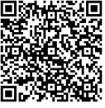
Knowledge Check:
Scan QR Code or visit the Link below to access the Knowledge Check
https://forms.office.com/r/CeMKSRzfwn
Notes:
RAs submit Knowledge Check Responses via QR code or link/URL on the next slide
RAs must submit to receive training credit

Slide 92
WBSCM Entitlement Knowledge Check
A
A. Download a PDF Entitlement Summary Report
A summary report will not contain this information. Additionally running a PDF report may not contain all the columns necessary to show all available information in a summary report.
Notes:
Review answer choices and explanations with RAs on next slides

Slide 93

WBSCM Entitlement Knowledge Check
A
A. Download a PDF Entitlement Summary Report
A summary report will not contain this information. Additionally running a PDF report may not contain all the columns necessary to show all available information in a summary report.
Notes:
Review answer choices and explanations with RAs on next slides

Slide 94
WBSCM Entitlement Knowledge Check
B
B. Download a PDF Entitlement Detail Report
An Entitlement Detail Report will include the information needed to check accurate available entitlement amounts. However, a PDF download may not include the column that contains this information.
Notes:
Review answer choices and explanations with RAs on next slides

Slide 95

WBSCM Entitlement Knowledge Check
B
B. Download a PDF Entitlement Detail Report
An Entitlement Detail Report will include the information needed to check accurate available entitlement amounts. However, a PDF download may not include the column that contains this information.
Notes:
Review answer choices and explanations with RAs on next slides

Slide 96
WBSCM Entitlement Knowledge Check
C
C. Download an Entitlement Summary Report in Excel
While downloading an Excel file will ensure all available information from the report is viewable, the summary report will not include the column that includes the Entitlement Amount Availabl.
Notes:
Review answer choices and explanations with RAs on next slides

Slide 97

WBSCM Entitlement Knowledge Check
C
C. Download an Entitlement Summary Report in Excel
While downloading an Excel file will ensure all available information from the report is viewable, the summary report will not include the column that includes the Entitlement Amount Availabl.
Notes:
Review answer choices and explanations with RAs on next slides

Slide 98
WBSCM Entitlement Knowledge Check
D
D. Download an Entitlement Detail Report in Excel
Exporting/Downloading an Entitlement Detail Report will include the information requested for Entitlement Amount Availabl and allows the information to be viewed in a file where all information is presented.
Notes:
Review answer choices and explanations with RAs on next slides

Slide 99

WBSCM Entitlement Knowledge Check
D
D. Download an Entitlement Detail Report in Excel
Exporting/Downloading an Entitlement Detail Report will include the information requested for Entitlement Amount Availabl and allows the information to be viewed in a file where all information is presented.
Notes:
Review answer choices and explanations with RAs

Slide 100
Questions?

Slide 101

For WBSCM Assistance
See Contact Information Section on WBSCM Transition Page

Slide 102

Lab Time:
Notes:
Users will practice pulling up Entitlement Reports in the training environment.

Slide 104
Contact Us
https://squaremeals.org/Programs/FDPWBSCMTransitionProject.aspx
Diana Chavarria
CN Technical Support
Diana.Chavarria@esc15.net
325.658.6571

